Slide 1
PBX Call Assist 3

Slide 2
Windows Client

Slide 3
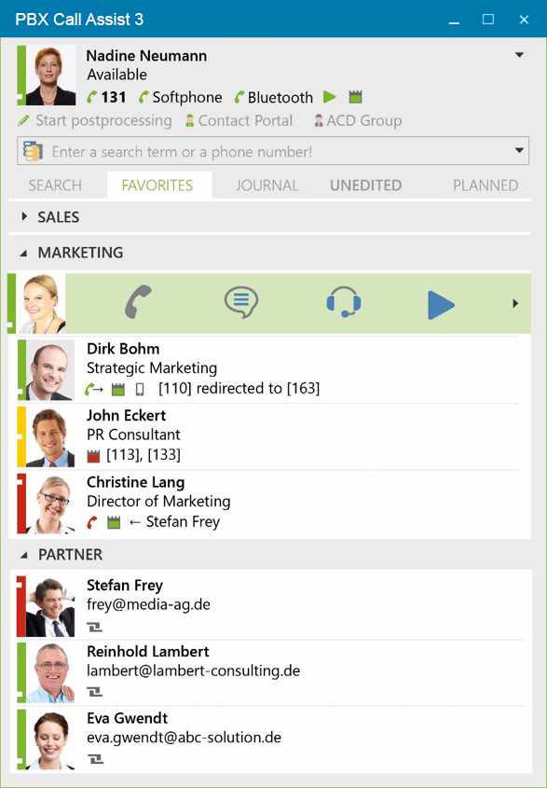

Connection – CTI , SIP and Bluetooth
131
CTI Line
Softphone
Softphone (SIP)
Bluetooth
CTI for Smartphones

Slide 4
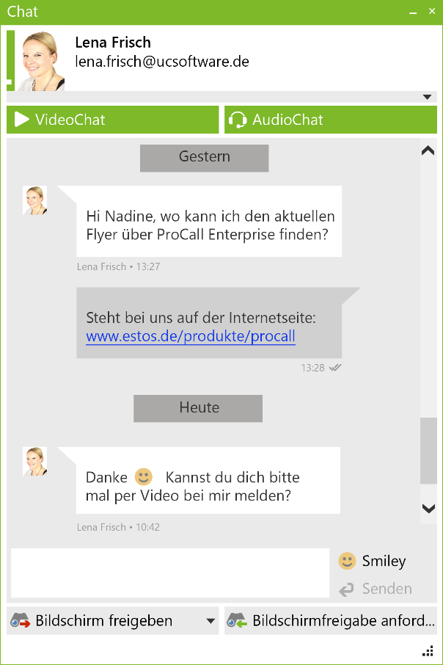

Chat
13:28

Slide 5
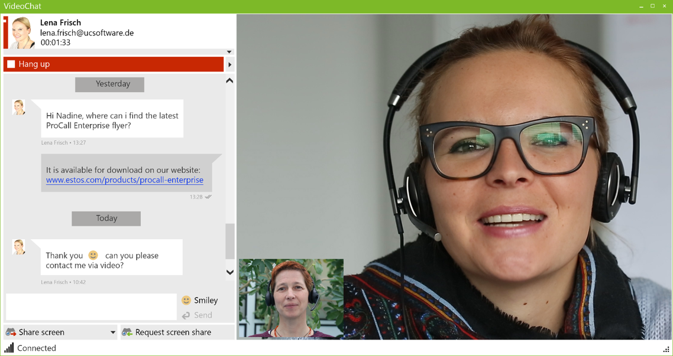
VideoChat

Slide 6
Screen Sharing

Slide 7
Other important new features
Active Directory Support
Computer Smartphone Integration (CSPI)
  Control
  Telephony via Bluetooth
Central update of the software
Notes:
Computer Smartphone Integration

Slide 8
Smartphone Apps & Mac Client

Slide 9
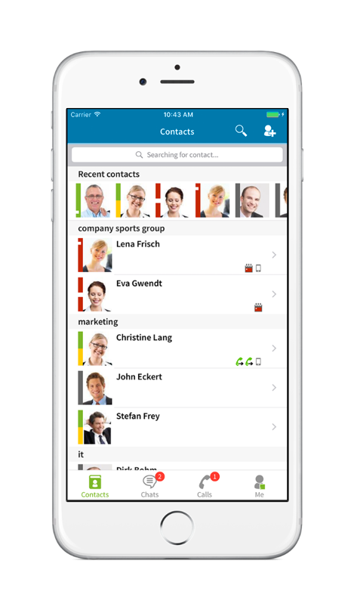
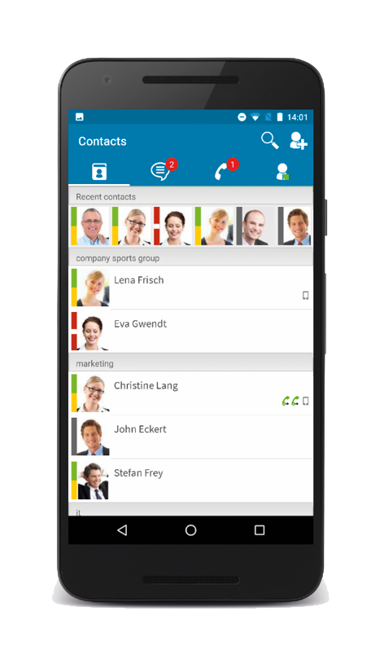

Smartphone Apps
SIP softphone and CTI funtions​
Synchronized phone journal​
Search, name resolution and contact details e.g. from CRM/ERP or industry software​
Instant messaging and presence management, incl. federation​
Audio/video chat on WebRTC Basis​
Easy commissioning with ProCall Mobility Services (optional)

Slide 10
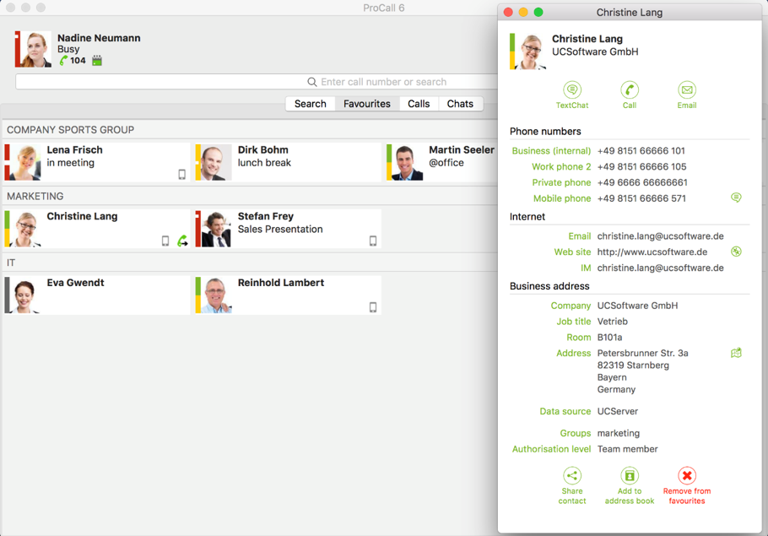
Mac Client
Computer Telephony Integration ( CTI )​
Instant messaging and presence management, incl. federation​
Integration of common CRM, ERP and industry software. Relevant information is immediately available for up-to-date contact data​
Search, name resolution for CTI calls and contact details, e.g. from CRM/ERP or groupware​
New UI in modern design and with improved usability​
Easy commissioning with ProCall Mobility Services (optional)

Slide 11
Call Assist 3 - Prices

Slide 12
PBX Call Assist 3
PBX Call Assist 3 | End customer
5 User license | 618,80 €
15 User license | 1.829,03 €
40 User license | 4.801,65 €
PBX Call Assist 3 Upgrade
5 User license | 297,50 €
15 User license | 879,41 €
40 User license | 2.308,60 €

Slide 13
Thank you

